Slide 1

C# Language Overview (Part I)
Data Types, Operators, Expressions, Statements, Console I/O, Loops, Arrays, Methods
Svetlin Nakov
Telerik Corporation
www.telerik.com

Slide 2

Table of Contents
Data Types
Operators
Expressions
Console I/O
Conditional Statements
Loops
Arrays
Methods

Slide 3




Primitive Data Types

Slide 4

Integer Types
Integer types are:
sbyte (-128 to 127): signed 8-bit
byte (0 to 255): unsigned 8-bit
short (-32,768 to 32,767): signed 16-bit
ushort (0 to 65,535): unsigned 16-bit
int (-2,147,483,648 to 2,147,483,647): signed 32-bit
uint (0 to 4,294,967,295): unsigned 32-bit

Slide 5


Integer Types (2)
More integer types:
long (-9,223,372,036,854,775,808 to 9,223,372,036,854,775,807): signed 64-bit
ulong (0 to 18,446,744,073,709,551,615): unsigned 64-bit

Slide 6
Integer Types – Example
Measuring time
Depending on the unit of measure we may use different data types:
byte centuries = 20; // Usually a small number
ushort years = 2000;
uint days = 730480;
ulong hours = 17531520; // May be a very big number
Console.WriteLine("{0} centuries is {1} years, or {2} days, or {3} hours.", centuries, years, days, hours);

Slide 7

Floating-Point Types
Floating-point types are:
float (±1.5 × 10⁻⁴⁵ to ±3.4 × 10³⁸): 32-bits, precision of 7 digits
double (±5.0 × 10⁻³²⁴ to ±1.7 × 10³⁰⁸): 64-bits, precision of 15-16 digits
The default value of floating-point types:
Is 0.0F for the float type
Is 0.0D for the double type

Slide 8
Fixed-Point Types
There is a special fixed-point real number type:
decimal (±1,0 × 10⁻²⁸ to ±7,9 × 10²⁸): 128-bits, precision of 28-29 digits
Used for financial calculations with low loss of precision
No round-off errors
The default value of decimal type is:
0.0M (M is the suffix for decimal numbers)

Slide 9

PI Precision – Example
See below the difference in precision when using float and double:
NOTE: The “f” suffix in the first statement!
Real numbers are by default interpreted as double!
One should explicitly convert them to float
float floatPI = 3.141592653589793238f;
double doublePI = 3.141592653589793238;
Console.WriteLine("Float PI is: {0}", floatPI);
Console.WriteLine("Double PI is: {0}", doublePI);

Slide 10
Abnormalities in the Floating-Point Calculations
Sometimes abnormalities can be observed when using floating-point numbers
Comparing floating-point numbers can not be done directly with the == operator
Example:
float a = 1.0f;
float b = 0.33f;
float sum = 1.33f;
bool equal = (a+b == sum); // False!!!
Console.WriteLine("a+b={0} sum={1} equal={2}",
a+b, sum, equal);

Slide 11


The Boolean Data Type
The Boolean Data Type:
Is declared by the bool keyword
Has two possible values: true and false
Is useful in logical expressions
The default value is false

Slide 12
Boolean Values – Example
Here we can see how boolean variables take values of true or false:
int a = 1;
int b = 2;
bool greaterAB = (a > b);
Console.WriteLine(greaterAB); // False
bool equalA1 = (a == 1);
Console.WriteLine(equalA1); // True

Slide 13
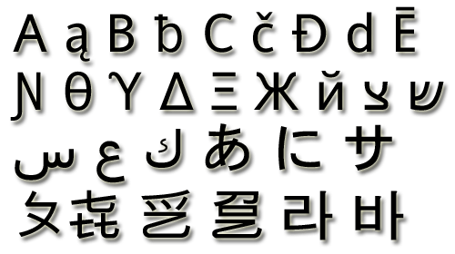
The Character Data Type
The Character Data Type:
Represents symbolic information
Is declared by the char keyword
Gives each symbol a corresponding integer code
Has a '\0' default value
Takes 16 bits of memory (from U+0000 to U+FFFF)

Slide 14
Characters and Codes
The example below shows that every symbol has an its unique code:
char symbol = 'a';
Console.WriteLine("The code of '{0}' is: {1}",
symbol, (int) symbol);
symbol = 'b';
Console.WriteLine("The code of '{0}' is: {1}",
symbol, (int) symbol);
symbol = 'A';
Console.WriteLine("The code of '{0}' is: {1}",
symbol, (int) symbol);

Slide 15
The String Data Type
The String Data Type:
Represents a sequence of characters
Is declared by the string keyword
Has a default value null (no value)
Strings are enclosed in quotes:
Strings can be concatenated
string s = "Microsoft .NET Framework";

Slide 16
Saying Hello – Example
Concatenating the two names of a person to obtain his full name:
NOTE: a space is missing between the two names! We have to add it manually
string firstName = "Ivan";
string lastName = "Ivanov";
Console.WriteLine("Hello, {0}!", firstName);
string fullName = firstName + " " + lastName;
Console.WriteLine("Your full name is {0}.", fullName);

Slide 17


The Object Type
The object type:
Is declared by the object keyword
Is the “parent” of all other types
Can take any types of values according to the needs

Slide 18
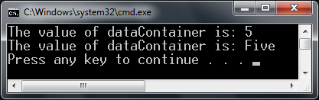
Using Objects
Example of an object variable taking different types of data:
object dataContainer = 5;
Console.Write("The value of dataContainer is: ");
Console.WriteLine(dataContainer);
dataContainer = "Five";
Console.Write ("The value of dataContainer is: ");
Console.WriteLine(dataContainer);

Slide 19

Variables and Identifiers

Slide 20
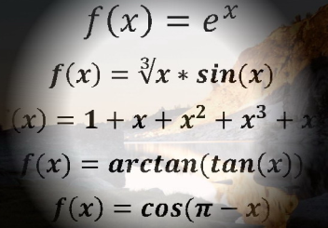
Declaring Variables
When declaring a variable we:
Specify its type
Specify its name (called identifier)
May give it an initial value
The syntax is the following:
Example:
<data_type> <identifier> [= <initialization>];
int height = 200;

Slide 21

Identifiers
Identifiers may consist of:
Letters (Unicode)
Digits [0-9]
Underscore "_"
Identifiers
Can begin only with a letter or an underscore
Cannot be a C# keyword

Slide 22
Identifiers (2)
Identifiers
Should have a descriptive name
It is recommended to use only Latin letters
Should be neither too long nor too short
Note:
In C# small letters are considered different than the capital letters (case sensitivity)

Slide 23
Identifiers – Examples
Examples of correct identifiers:
Examples of incorrect identifiers:
int New = 2; // Here N is capital
int _2Pac; // This identifiers begins with _
string поздрав = "Hello"; // Unicode symbols used
// The following is more appropriate:
string greeting = "Hello";
int n = 100; // Undescriptive
int numberOfClients = 100; // Descriptive
// Overdescriptive identifier:
int numberOfPrivateClientOfTheFirm = 100;
int new; // new is a keyword
int 2Pac; // Cannot begin with a digit

Slide 24

Literals

Slide 25


Integer Literals
Examples of integer literals
The '0x' and '0X' prefixes mean a hexadecimal value, e.g. 0xA8F1
The 'u' and 'U' suffixes mean a ulong or uint type, e.g. 12345678U
The 'l' and 'L' suffixes mean a long or ulong type, e.g. 9876543L

Slide 26

Integer Literals – Example
// The following variables are
// initialized with the same value:
int numberInHex = -0x10;
int numberInDec = -16;
// The following causes an error,
because 234u is of type uint
int unsignedInt = 234u;
// The following causes an error,
because 234L is of type long
int longInt = 234L;
Note: the letter ‘l’ is easily confused with the digit ‘1’ so it’s better to use ‘L’!!!

Slide 27
Real Literals
The real literals:
Are used for values of type float and double
May consist of digits, a sign and “.”
May be in exponential formatting
The “f” and “F” suffixes mean float
The “d” and “D” suffixes mean double
The default interpretation is double

Slide 28
Real Literals – Example
Example of incorrect float literal:
A correct way to assign floating-point value (using also the exponential format):
// The following causes an error
// because 12.5 is double by default
float realNumber = 12.5;
// The following is the correct
// way of assigning the value:
float realNumber = 12.5f;
// This is the same value in exponential format:
realNumber = 1.25e+1f;

Slide 29

Character Literals
The character literals:
Are used for values of the char type
Consist of two single quotes surrounding the value: '<value>'
The value may be:
Symbol
The code of the symbol
Escaping sequence

Slide 30

Escaping Sequences
Escaping sequences are:
Means of presenting a symbol that is usually interpreted otherwise (like ')
Means of presenting system symbols (like the new line symbol)
Common escaping sequences are:
\' for single quote
\" for double quote
\\ for backslash
\n for new line

Slide 31
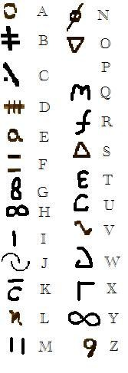
Character Literals – Example
Examples of different character literals:
char symbol = 'a'; // An ordinary symbol
symbol = '\u0061'; // Unicode symbol code in // a hexadecimal format
symbol = '\''; // Assigning the single quote symbol
symbol = '\\'; // Assigning the backslash symbol
symbol = "a"; // Incorrect: use single quotes

Slide 32
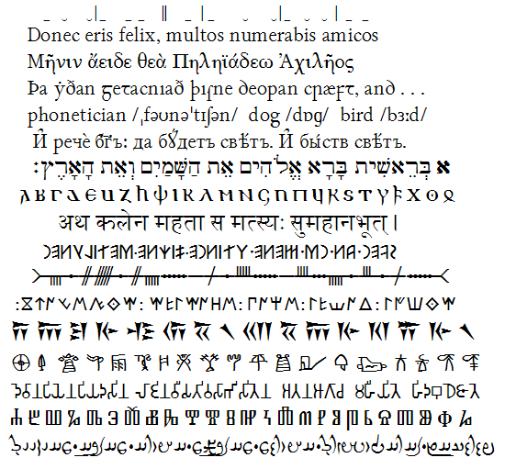
String Literals
String literals:
Are used for values of the string type
Consist of two double quotes surrounding the value: "<value>"
May have a @ prefix which ignores the used escaping sequences
The value is a sequence of character literals

Slide 33
String Literals – Example
Benefits of quoted strings (the @ prefix):
In quoted strings \" is used instead of ""!
// Here is a string literal using escape sequences
string quotation = "\"Hello, Jude\", he said.";
string path = "C:\\WINNT\\Darts\\Darts.exe";
// Here is an example of the usage of @
quotation = @"""Hello, Jimmy!"", she answered.";
path = @"C:\WINNT\Darts\Darts.exe";

Slide 34


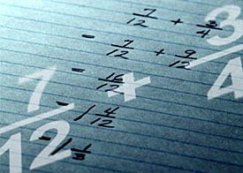

Operators in C#

Slide 35
Categories of Operators in C#
Category | Operators
Arithmetic | + - * / % ++ --
Logical | && || ^ !
Binary | & | ^ ~ << >>
Comparison | == != < > <= >=
Assignment | = += -= *= /= %= &= |= ^= <<= >>=
String concatenation | +
Type conversion | is as typeof
Other | . [] () ?: new

Slide 36
Operators Precedence
Precedence | Operators
Highest | ++ -- (postfix) new typeof
 | ++ -- (prefix) + - (unary) ! ~
 | * / %
 | + -
 | << >>
 | < > <= >= is as
 | == !=
 | &
Lower | ^

Slide 37
Operators Precedence (2)
Precedence | Operators
Higher | |
 | &&
 | ||
 | ?:
Lowest | = *= /= %= += -= <<= >>= &= ^= |=
Parenthesis operator always has highest precedence
Note: prefer using parentheses, even when it seems stupid to do so

Slide 38

Arithmetic Operators
Arithmetic operators +, -, * are the same as in math
Division operator / if used on integers returns integer (without rounding)
Remainder operator % returns the remainder from division of integers
The special addition operator ++ increments a variable

Slide 39
Arithmetic Operators – Example
int squarePerimeter = 17;
double squareSide = squarePerimeter/4.0;
double squareArea = squareSide*squareSide;
Console.WriteLine(squareSide); // 4.25
Console.WriteLine(squareArea); // 18.0625
int a = 5;
int b = 4;
Console.WriteLine( a + b ); // 9
Console.WriteLine( a + b++ ); // 9
Console.WriteLine( a + b ); // 10
Console.WriteLine( a + (++b) ); // 11
Console.WriteLine( a + b ); // 11
Console.WriteLine(11 / 3); // 3
Console.WriteLine(11 % 3); // 2
Console.WriteLine(12 / 3); // 4

Slide 40
Logical Operators
Logical operators take boolean operands and return boolean result
Operator ! turns true to false and false to true
Behavior of the operators &&, || and ^ (1 == true, 0 == false) :
Operation | || | || | || | || | && | && | && | && | ^ | ^ | ^ | ^
Operand1 | 0 | 0 | 1 | 1 | 0 | 0 | 1 | 1 | 0 | 0 | 1 | 1
Operand2 | 0 | 1 | 0 | 1 | 0 | 1 | 0 | 1 | 0 | 1 | 0 | 1
Result | 0 | 1 | 1 | 1 | 0 | 0 | 0 | 1 | 0 | 1 | 1 | 0

Slide 41

Logical Operators – Example
Using the logical operators:
bool a = true;
bool b = false;
Console.WriteLine(a && b); // False
Console.WriteLine(a || b); // True
Console.WriteLine(a ^ b); // True
Console.WriteLine(!b); // True
Console.WriteLine(b || true); // True
Console.WriteLine(b && true); // False
Console.WriteLine(a || true); // True
Console.WriteLine(a && true); // True
Console.WriteLine(!a); // False
Console.WriteLine((5>7) ^ (a==b)); // False

Slide 42
Bitwise Operators
Bitwise operator ~ turns all 0 to 1 and all 1 to 0
Like ! for boolean expressions but bit by bit
The operators |, & and ^ behave like ||, && and ^ for boolean expressions but bit by bit
The << and >> move the bits (left or right)
Behavior of the operators|, & and ^:
Operation | | | | | | | | | & | & | & | & | ^ | ^ | ^ | ^
Operand1 | 0 | 0 | 1 | 1 | 0 | 0 | 1 | 1 | 0 | 0 | 1 | 1
Operand2 | 0 | 1 | 0 | 1 | 0 | 1 | 0 | 1 | 0 | 1 | 0 | 1
Result | 0 | 1 | 1 | 1 | 0 | 0 | 0 | 1 | 0 | 1 | 1 | 0

Slide 43

Bitwise Operators (2)
Bitwise operators are used on integer numbers (byte, sbyte, int, uint, long, ulong)
Bitwise operators are applied bit by bit
Examples:
ushort a = 3; // 00000011
ushort b = 5; // 00000101
Console.WriteLine( a | b); // 00000111
Console.WriteLine( a & b); // 00000001
Console.WriteLine( a ^ b); // 00000110
Console.WriteLine(~a & b); // 00000100
Console.WriteLine( a<<1 ); // 00000110
Console.WriteLine( a>>1 ); // 00000001

Slide 44

Comparison Operators
Comparison operators are used to compare variables
==, <, >, >=, <=, !=
Comparison operators example:
int a = 5;
int b = 4;
Console.WriteLine(a >= b); // True
Console.WriteLine(a != b); // True
Console.WriteLine(a > b); // False
Console.WriteLine(a == b); // False
Console.WriteLine(a == a); // True
Console.WriteLine(a != ++b); // False

Slide 45

Assignment Operators
Assignment operators are used to assign a value to a variable ,
=, +=, -=, |=, ...
Assignment operators example:
int x = 6;
int y = 4;
Console.WriteLine(y *= 2); // 8
int z = y = 3; // y=3 and z=3
Console.WriteLine(z); // 3
Console.WriteLine(x |= 1); // 7
Console.WriteLine(x += 3); // 10
Console.WriteLine(x /= 2); // 5

Slide 46

Other Operators
String concatenation operator + is used to concatenate strings
If the second operand is not a string, it is converted to string automatically
string first = "First";
string second = "Second";
Console.WriteLine(first + second); // FirstSecond
string output = "The number is : ";
int number = 5;
Console.WriteLine(output + number);
// The number is : 5

Slide 47
Other Operators (2)
Member access operator . is used to access object members
Square brackets [] are used with arrays indexers and attributes
Parentheses ( ) are used to override the default operator precedence
Class cast operator (type) is used to cast one compatible type to another

Slide 48
Other Operators (3)
Conditional operator ?: has the form
(if b is true then the result is x else the result is y)
The new operator is used to create new objects
The typeof operator returns System.Type object (the reflection of a type)
The is operator checks if an object is compatible with given type
b ? x : y

Slide 49
Other Operators – Example
Using some other operators:
int a = 6;
int b = 4;
Console.WriteLine(a > b ? "a>b" : "b>=a"); // a>b
Console.WriteLine((long) a); // 6
int c = b = 3; // b=3; followed by c=3;
Console.WriteLine(c); // 3
Console.WriteLine(a is int); // True
Console.WriteLine((a+b)/2); // 4
Console.WriteLine(typeof(int)); // System.Int32
int d = new int();
Console.WriteLine(d); // 0

Slide 50
Type Conversions
Example of implicit and explicit conversions:
Note: explicit conversion may be used even if not required by the compiler
float heightInMeters = 1.74f; // Explicit conversion
double maxHeight = heightInMeters; // Implicit
double minHeight = (double) heightInMeters; // Explicit
float actualHeight = (float) maxHeight; // Explicit
float maxHeightFloat = maxHeight; // Compilation error!

Slide 51
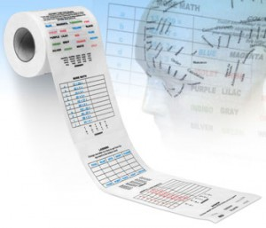
Expressions

Slide 52
Expressions
Expressions are sequences of operators, literals and variables that are evaluated to some value
Examples:
int r = (150-20) / 2 + 5;
// Expression for calculation of circle area
double surface = Math.PI * r * r;
// Expression for calculation of circle perimeter
double perimeter = 2 * Math.PI * r;

Slide 53
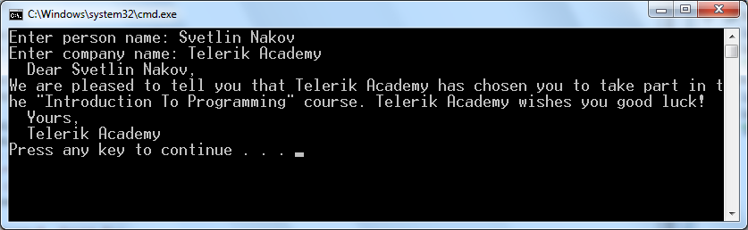
Using to the Console
Printing / Reading Strings and Numbers
53

Slide 54
The Console Class
Provides methods for input and output
Input
Read(…) – reads a single character
ReadLine(…) – reads a single line of characters
Output
Write(…) – prints the specified argument on the console
WriteLine(…) – prints specified data to the console and moves to the next line

Slide 55
Console.Write(…)
Printing an integer variable
int a = 15;
...
Console.Write(a); // 15
Printing more than one variable using a formatting string
double a = 15.5;
int b = 14;
...
Console.Write("{0} + {1} = {2}", a, b, a + b);
// 15.5 + 14 = 29.5
Next print operation will start from the same line

Slide 56
Console.WriteLine(…)
Printing a string variable
string str = "Hello C#!";
...
Console.WriteLine(str);
Printing more than one variable using a formatting string
string name = "Marry";
int year = 1987;
...
Console.Write("{0} was born in {1}.", name, year);
// Marry was born in 1987.
Next printing will start from the next line

Slide 57
Printing to the Console – Example
static void Main()
{
string name = "Peter";
int age = 18;
string town = "Sofia";
Console.Write("{0} is {1} years old from {2}.",
name, age, town);
// Result: Peter is 18 years old from Sofia.
Console.Write("This is on the same line!");
Console.WriteLine("Next sentence will be" +
" on a new line.");
Console.WriteLine("Bye, bye, {0} from {1}.",
name, town);
}

Slide 58
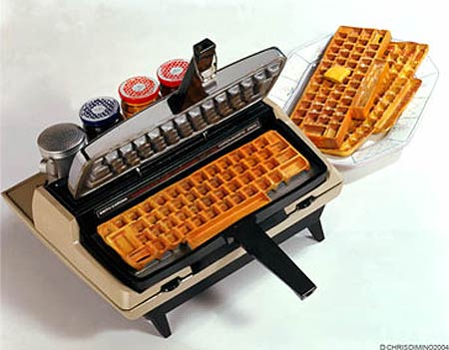
Reading from the Console
We use the console to read information from the command line
We can read:
Characters
Strings
Numeral types (after conversion)
To read from the console we use the methods Console.Read() and Console.ReadLine()

Slide 59
Console.ReadLine()
Gets a line of characters
Returns a string value
Returns null if the end of the input is reached
Console.Write("Please enter your first name: ");
string firstName = Console.ReadLine();
Console.Write("Please enter your last name: ");
string lastName = Console.ReadLine();
Console.WriteLine("Hello, {0} {1}!",
firstName, lastName);

Slide 60
Reading Numeral Types
Numeral types can not be read directly from the console
To read a numeral type do following:
Read a string value
Convert (parse) it to the required numeral type
int.Parse(string) – parses a string to int
string str = Console.ReadLine()
int number = int.Parse(str);
Console.WriteLine("You entered: {0}", number);

Slide 61
Reading Numeral Types (2)
Another way to parse string to numeral type is to use int.TryParse(…) method
Sets default value for the type if the parse fails
Returns bool
True if the parse is successfull
False if it fails
int a;
string line = Console.ReadLine();
int.TryParse(line, out a);
The result from the parse will be assigned to the variable parseResult

Slide 62
Converting Strings to Numbers
Numeral types have a method Parse(…) for extracting the numeral value from a string
int.Parse(string) – string → int
long.Parse(string) – string → long
float.Parse(string) – string → float
Causes FormatException in case of error
string s = "123";
int i = int.Parse(s); // i = 123
long l = long.Parse(s); // l = 123L
string invalid = "xxx1845";
int value = int.Parse(invalid); // FormatException

Slide 63

Conditional Statements
Implementing Conditional Logic

Slide 64
The if Statement
The most simple conditional statement
Enables you to test for a condition
Branch to different parts of the code depending on the result
The simplest form of an if statement:
if (condition)
{
statements;
}

Slide 65
The if Statement – Example
static void Main()
{
Console.WriteLine("Enter two numbers.");
int biggerNumber = int.Parse(Console.ReadLine());
int smallerNumber = int.Parse(Console.ReadLine());
if (smallerNumber > biggerNumber)
{
biggerNumber = smallerNumber;
}
Console.WriteLine("The greater number is: {0}",
biggerNumber);
}

Slide 66
The if-else Statement
More complex and useful conditional statement
Executes one branch if the condition is true, and another if it is false
The simplest form of an if-else statement:
if (expression)
{
statement1;
}
else
{
statement2;
}

Slide 67
if-else Statement – Example
Checking a number if it is odd or even
string s = Console.ReadLine();
int number = int.Parse(s);
if (number % 2 == 0)
{
Console.WriteLine("This number is even.");
}
else
{
Console.WriteLine("This number is odd.");
}

Slide 68
Nested if Statements
if and if-else statements can be nested, i.e. used inside another if or else statement
Every else corresponds to its closest preceding if
if (expression)
{
if (expression)
{
statement;
}
else
{
statement;
}
}
else
statement;

Slide 69
Nested if Statements – Example
if (first == second)
{
Console.WriteLine(
"These two numbers are equal.");
}
else
{
if (first > second)
{
Console.WriteLine(
"The first number is bigger.");
}
else
{
Console.WriteLine("The second is bigger.");
}
}

Slide 70
The switch-case Statement
Selects for execution a statement from a list depending on the value of the switch expression
switch (day)
{
case 1: Console.WriteLine("Monday"); break;
case 2: Console.WriteLine("Tuesday"); break;
case 3: Console.WriteLine("Wednesday"); break;
case 4: Console.WriteLine("Thursday"); break;
case 5: Console.WriteLine("Friday"); break;
case 6: Console.WriteLine("Saturday"); break;
case 7: Console.WriteLine("Sunday"); break;
default: Console.WriteLine("Error!"); break;
}

Slide 71

Loops
Repeating Statements Multiple Times

Slide 72
How To Use While Loop?
The simplest and most frequently used loop
The repeat condition
Returns a boolean result of true or false
Also called loop condition
while (condition)
{
statements;
}

Slide 73
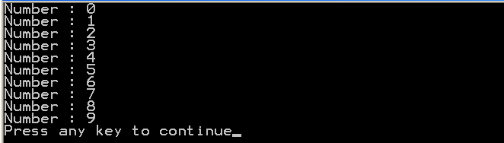

While Loop – Example
int counter = 0;
while (counter < 10)
{
Console.WriteLine("Number : {0}", counter);
counter++;
}

Slide 74

Using Do-While Loop
Another loop structure is:
The block of statements is repeated
While the boolean loop condition holds
The loop is executed at least once
do
{
statements;
}
while (condition);

Slide 75
Factorial – Example
Calculating N factorial
static void Main()
{
int n = Convert.ToInt32(Console.ReadLine());
int factorial = 1;
do
{
factorial *= n;
n--;
}
while (n > 0);
Console.WriteLine("n! = " + factorial);
}

Slide 76

For Loops
The typical for loop syntax is:
Consists of
Initialization statement
Boolean test expression
Update statement
Loop body block
for (initialization; test; update) { statements; }

Slide 77

N^M – Example
Calculating n to power m (denoted as n^m):
static void Main()
{
int n = int.Parse(Console.ReadLine());
int m = int.Parse(Console.ReadLine());
decimal result = 1;
for (int i=0; i<m; i++)
{
result *= n;
}
Console.WriteLine("n^m = " + result);
}

Slide 78
For-Each Loops
The typical foreach loop syntax is:
Iterates over all elements of a collection
The element is the loop variable that takes sequentially all collection values
The collection can be list, array or other group of elements of the same type
foreach (Type element in collection) { statements; }

Slide 79
foreach Loop – Example
Example of foreach loop:
string[] days = new string[] {
"Monday", "Tuesday", "Wednesday", "Thursday",
"Friday", "Saturday", "Sunday" };
foreach (String day in days)
{
Console.WriteLine(day);
}
The above loop iterates of the array of days
The variable day takes all its values

Slide 80
Nested Loops
A composition of loops is called a nested loop
A loop inside another loop
Example:
for (initialization; test; update)
{
for (initialization; test; update)
{
statements;
}
…
}

Slide 81
Nested Loops – Examples
Print all combinations from TOTO 6/49
Warning: execution of this code could take too long time.
static void Main()
{
int i1, i2, i3, i4, i5, i6;
for (i1 = 1; i1 <= 44; i1++)
for (i2 = i1 + 1; i2 <= 45; i2++)
for (i3 = i2 + 1; i3 <= 46; i3++)
for (i4 = i3 + 1; i4 <= 47; i4++)
for (i5 = i4 + 1; i5 <= 48; i5++)
for (i6 = i5 + 1; i6 <= 49; i6++)
Console.WriteLine("{0} {1} {2} {3} {4} {5}",
i1, i2, i3, i4, i5, i6);
}

Slide 82

Arrays

Slide 83

What are Arrays?
An array is a sequence of elements
All elements are of the same type
The order of the elements is fixed
Has fixed size (Array.Length)
Element of an array
0 1 2 3 4
Element index
Array of 5 elements
… | … | … | … | …

Slide 84

Declaring Arrays
Declaration defines the type of the elements
Square brackets [] mean "array"
Examples:
Declaring array of integers:
Declaring array of strings:
int[] myIntArray;
string[] myStringArray;

Slide 85

Creating Arrays
Use the operator new
Specify array length
Example creating (allocating) array of 5 integers:
myIntArray = new int[5];
0 1 2 3 4
myIntArray
… | … | … | … | …
managed heap
(dynamic memory)

Slide 86
Creating and Initializing Arrays
Creating and initializing can be done together:
The new operator is not required when using curly brackets initialization
myIntArray = {1, 2, 3, 4, 5};
0 1 2 3 4
myIntArray
… | … | … | … | …
managed heap
(dynamic memory)

Slide 87

Creating Array – Example
Creating an array that contains the names of the days of the week
string[] daysOfWeek =
{
"Monday",
"Tuesday",
"Wednesday",
"Thursday",
"Friday",
"Saturday",
"Sunday"
};

Slide 88
How to Access Array Element?
Array elements are accessed using the square brackets operator [] (indexer)
Array indexer takes element’s index as parameter
The first element has index 0
The last element has index Length-1
Array elements can be retrieved and changed by the [] operator

Slide 89
Reversing an Array – Example
Reversing the contents of an array
int[] array = new int[] {1, 2, 3, 4, 5};
// Get array size
int length = array.Length;
// Declare and create the reversed array
int[] reversed = new int[length];
// Initialize the reversed array
for (int index = 0; index < length; index++)
{
reversed[length-index-1] = array[index];
}

Slide 90

Processing Arrays: foreach
How foreach loop works?
type – the type of the element
value – local name of variable
array – processing array
Used when no indexing is needed
All elements are accessed one by one
Elements can not be modified (read only)
foreach (type value in array)

Slide 91
Processing Arrays Using foreach – Example
Print all elements of a string[] array:
string[] capitals =
{
"Sofia",
"Washington",
"London",
"Paris"
};
foreach (string capital in capitals)
{
Console.WriteLine(capital);
}

Slide 92
Multidimensional Arrays
Multidimensional arrays have more than one dimension (2, 3, …)
The most important multidimensional arrays are the 2-dimensional
Known as matrices or tables
Example of matrix of integers with 2 rows and 4 columns:
0 | 1 | 2 | 3
0
1
5 | 0 | -2 | 4
5 | 6 | 7 | 8

Slide 93
Declaring and Creating Multidimensional Arrays
Declaring multidimensional arrays:
Creating a multidimensional array
Use new keyword
Must specify the size of each dimension
int[,] intMatrix;
float[,] floatMatrix;
string[,,] strCube;
int[,] intMatrix = new int[3, 4];
float[,] floatMatrix = new float[8, 2];
string[,,] stringCube = new string[5, 5, 5];

Slide 94
Creating and Initializing Multidimensional Arrays
Creating and initializing with values multidimensional array:
Matrices are represented by a list of rows
Rows consist of list of values
The first dimension comes first, the second comes next (inside the first)
int[,] matrix =
{
{1, 2, 3, 4}, // row 0 values
{5, 6, 7, 8}, // row 1 values
}; // The matrix size is 2 x 4 (2 rows, 4 cols)

Slide 95
Reading Matrix – Example
Reading a matrix from the console
int rows = int.Parse(Console.ReadLine());
int cols = int.Parse(Console.ReadLine());
int[,] matrix = new int[rows, cols];
for (int row=0; row<rows; row++)
{
for (int col=0; col<cols; col++)
{
Console.Write("matrix[{0},{1}] = ",
row, col);
matrix[row, col] =
int.Parse(Console.ReadLine());
}
}

Slide 96
Printing Matrix – Example
Printing a matrix on the console:
for (int row=0; row<matrix.GetLength(0); row++)
{
for (int col=0; col<matrix.GetLength(1); col++)
{
Console.Write("{0} ", matrix[row, col]);
}
Console.WriteLine();
}

Slide 97

Methods
Declaring and Using Methods

Slide 98

What is a Method?
A method is a kind of building block that solves a small problem
A piece of code that has a name and can be called from the other code
Can take parameters and return a value
Methods allow programmers to construct large programs from simple pieces
Methods are also known as functions, procedures, and subroutines

Slide 99

Declaring and Creating Methods
using System;
class MethodExample
{
static void PrintLogo()
{
Console.WriteLine("Telerik Corp.");
Console.WriteLine("www.telerik.com");
}
static void Main()
{
// ...
}
}
Methods are always declared inside a class
Main() is also a method like all others

Slide 100

Calling Methods
To call a method, simply use:
The method’s name
Parentheses (don’t forget them!)
A semicolon (;)
This will execute the code in the method’s body and will result in printing the following:
PrintLogo();
Telerik Corp.
www.telerik.com

Slide 101

Defining and Using Method Parameters
static void PrintSign(int number)
{
if (number > 0)
Console.WriteLine("Positive");
else if (number < 0)
Console.WriteLine("Negative");
else
Console.WriteLine("Zero");
}
Method’s behavior depends on its parameters
Parameters can be of any type
int, double, string, etc.
arrays (int[], double[], etc.)

Slide 102
Defining and Using Method Parameters (2)
Methods can have as many parameters as needed:
The following syntax is not valid:
static void PrintMax(float number1, float number2)
{
float max = number1;
if (number2 > number1)
max = number2;
Console.WriteLine("Maximal number: {0}", max);
}
static void PrintMax(float number1, number2)

Slide 103

Calling Methods with Parameters
To call a method and pass values to its parameters:
Use the method’s name, followed by a list of expressions for each parameter
Examples:
PrintSign(-5);
PrintSign(balance);
PrintSign(2+3);
PrintMax(100, 200);
PrintMax(oldQuantity * 1.5, quantity * 2);

Slide 104
Returning Values From Methods
A method can return a value to its caller
Returned value:
Can be assigned to a variable:
Can be used in expressions:
Can be passed to another method:
string message = Console.ReadLine();
// Console.ReadLine() returns a string
float price = GetPrice() * quantity * 1.20;
int age = int.Parse(Console.ReadLine());

Slide 105
Defining Methods That Return a Value
Instead of void, specify the type of data to return
Methods can return any type of data (int, string, array, etc.)
void methods do not return anything
The combination of method's name and parameters is called method signature
Use return keyword to return a result
static int Multiply(int firstNum, int secondNum)
{
return firstNum * secondNum;
}

Slide 106
The return Statement
The return statement:
Immediately terminates method’s execution
Returns specified expression to the caller
Example:
To terminate void method, use just:
Return can be used several times in a method body
return -1;
return;

Slide 107
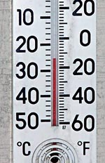
Temperature Conversion – Example
Convert temperature from Fahrenheit to Celsius:
static double FahrenheitToCelsius(double degrees)
{
double celsius = (degrees - 32) * 5 / 9;
return celsius;
}
static void Main()
{
Console.Write("Temperature in Fahrenheit: ");
double t = Double.Parse(Console.ReadLine());
t = FahrenheitToCelsius(t);
Console.Write("Temperature in Celsius: {0}", t);
}

Slide 108
Homework
Write a program that, for a given two integer numbers N and X, calculates the sum S = 1 + 1!/X + 2!/X² + … + N!/X^{N}
Write a program that reads a number N and calculates the sum of the first N members of the sequence of Fibonacci: 0, 1, 1, 2, 3, 5, 8, 13, 21, 34, 55, 89, 144, 233, 377, …
Each member of the Fibonacci sequence (except the first two) is a sum of the previous two members.
Write a program that calculates the greatest common divisor (GCD) of given two numbers. Use the Euclidean algorithm (find it in Internet).

Slide 109
Homework (2)
Write a program that fills a matrix of size (N, N) as shown in the examples (for N=4):
16 | 15 | 13 | 10
14 | 12 | 9 | 6
11 | 8 | 5 | 3
7 | 4 | 2 | 1
7 | 11 | 14 | 16
4 | 8 | 12 | 15
2 | 5 | 9 | 13
1 | 3 | 6 | 10
a)
b)
1 | 12 | 11 | 10
2 | 13 | 16 | 9
3 | 14 | 15 | 8
4 | 5 | 6 | 7
10 | 11 | 12 | 13
9 | 2 | 3 | 14
8 | 1 | 4 | 15
7 | 6 | 5 | 16
*c)
*d)

Slide 110
Homework (3)
* Write a program that converts a number in the range [0...999] to a text corresponding to its English pronunciation. Examples:
0 → "Zero"
273 → "Two hundred seventy three"
400 → "Four hundred"
501 → "Five hundred and one"
711 → "Severn hundred and eleven"

Slide 111



C# Language Overview (Part I)
http://aspnetcourse.telerik.com

